Slide 1
The impact of President trump’s first term on immigrant children in detention facilities
SML310: Final Project
Mia Rosini

Slide 2
Table of contents
Research Question
Motivation
Data Collection
Methods
Results
Discussion & Conclusion
Introduction
Literature Review
Notes:
Before I dive into my research, I thought it would be a good idea to give some background on the topic, which is immigration policy

Slide 3
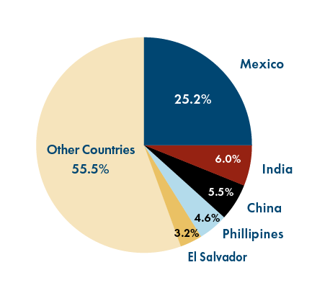
Research question
- Were immigrant children of certain nationalities, genders, and ages more likely to be kept over the legal time limit in a detention facility than others?
Logistic Regression Model
Naïve Bayes Model
Logistic Regression Classification Model
Decision Tree Model
Notes:
Under the Trump administration, immigrant children have been kept in abysmal conditions at detention facilities. This report aims to answer this overarching question: Were immigrant children of certain nationalities, genders, and ages more likely to spend more than 72 hours in a detention facility than others?
This report will utilize logistic regression and classification models to answer this question

Slide 4
Literature review
Anyikwa et al. (2019): Researchers evaluates how immigration laws under the Trump Administration have negatively impacted immigrant children and contributed to the psychological trauma and health consequences they face. The Trump administration has implemented policies that violate human rights.
Schachear (2020): Schachear’s research demonstrates that Trump’s policies separating families not only excludes newcomers but also prevents those immigrants already in the United States’ from feeling a valued part of the United States
White House Memo (2020): Trump’s administration has implemented policies that are protecting U.S. citizens from the harms caused by immigrants to the economy
Notes:
Research Question: Were immigrant children of certain nationalities, genders, and ages more likely to be kept over the legal time limit in a detention facility than others?
One side of the debate argues that the Trump administration has implemented policies that violate human
rights. “Policy Point-Counterpoint: Are the Trump Administration’s Immigration Policies Just or Unjust
for Immigrant Children in Particular and the Country in General?”, written by Dr. Victoria A. Anyikwa
and colleagues, evaluates how immigration laws under the Trump Administration have negatively impacted
immigrant children and contributed to the psychological trauma and health consequences they face (Anyikwa
et al 2019, 1). The Trump administration has implemented a series of “no-nonsense” policies; his antiimmigration
rhetoric has fueled anti-immigrant sentiment and the creation of hate groups to promote negative
attitudes among U.S. citizens (Anyikwa 6).
“Family Separation and Lives in Limbo: U.S. Immigration Policy in the 1920s and during the Trump
Administration”, written by Yael Schachear, examines policies and practices that are related to family
separation among immigrants in the 1920s and now. It asserts that the Trump administration supports family
separations and deporting critically ill immigrant children. It concludes that the current administration goes
beyond the policies from the 1920s and has imposed policies to restrict admission and impede the successful
integration of immigrants (Schachear 2020, 197). Schachear’s research demonstrates that Trump’s policies
separating families not only excludes newcomers but also prevents those immigrants already in the United
States’ from feeling a valued part of the United States (193).
The other side of the scholarly debate argues that Trump’s administration has implemented policies that
are protecting U.S. citizens from the harms caused by immigrants to the economy. Donald Trump’s White
House released a memo outlining that immigrants are a strain on public resources. The rate of low-skilled
immigration in the United States puts a strain on public resources (welfare programs) and increases the
burden of American taxpayers. Trump’s immigration reform will stem the tide of low-skilled immigration
to secure the borders, curb the low-skilled workers by ending extended-family chain migration, and end the
visa lottery system (White House).

Slide 5
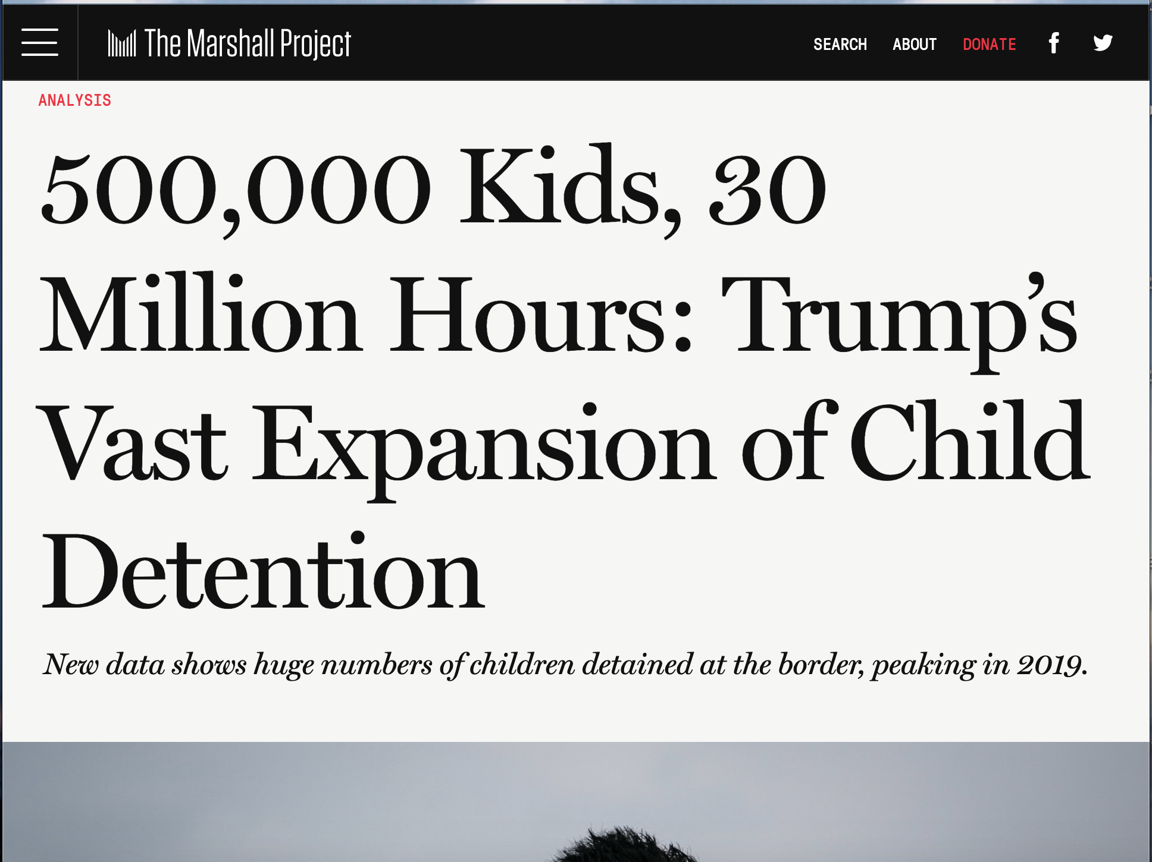
Data collection
Variable | Meaning
date_in | custody book-in time and date
date_out | custody book-out time and date
app_date | apprehension date
hours_in_custody | time in custody in hours
age_group | age group of child (grouped by every 2 years)
gender | child gender
citizenship | child country of citizenship
border | border
field_office | field office name
source | data source
Notes:
The data for this report was from the U.S. Customs and Border Protection in October, 2020. The dataset is a combination of two sources:
Office of Field Operations child detentions: Detentions of children at all ports of entry by the U.S. Customs and Border Protection Border Patrol between mid-January 2017 and late January of 2020
Border Patrol child detentions: Detentions of children between all ports of entry by the U.S. Customs and Border Protection Office of Field Operations between mid-January 2017 and mid-June 2020
The original dataset had the variables you can see in the table: custody book-in time and date, custody book-out time and date, apprehension date, time in custody in hours, age group of child, child gender, child country of citizenship, border, field office name, data source.

Slide 6
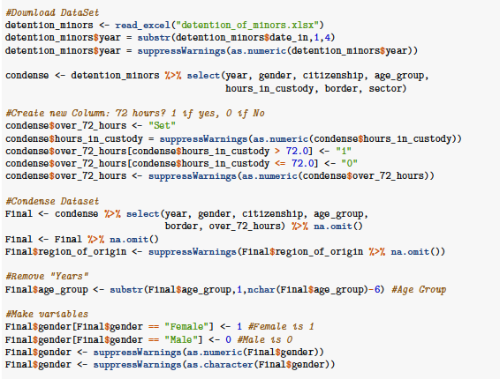
Data manipulation
FINAL DATASET
Variable | Meaning
year | year of book-in
gender | gender of child (1 = female)
age_group | age group of child (1-7 age groups)
region_of_origin | region of origin of child
over_72_hours | Binary: 1: kept over 72 hours 0: kept under 72 hours
Notes:
After gathering the data, a “Year” column was added, and the custody book-in time and date, custody book-out time and date, border, field office name, and data source variables were removed. Next, a binary outcome variable was added called: “Over_72_hours”. It was set to 1 if the number of hours a child was held in custody was greater than 72, and 0 if the number of hours a child was held in custody was less than 72.
The variables of age group and gender were changed to characters to feed into the logistic regression. This dataset was merged with another dataset contained regions of the world and the corresponding countries in each respective region. These regions included: Asia, Europe, Africa, Central America, Oceania, Caribbean, South America, Oceania, Caribbean, South America, Canada, Middle East, Mexico. The citizenship column was then removed from this final dataset.
The final dataset contained columns: Year, Gender, Age Group, Region of Origin, Over_72_hours. Each row represented an immigrant children held in a detention facility.
Final Dataset: Year, Gender, Age Group, Region of Origin, Over_72_hours
Over_72_hours = 1 if the child was kept over 72-hour legal limit
Over_72_hours = 0 if the child was kept within the 72-hour legal limit

Slide 7
Exploratory data analysis
Number of immigrant children detained in each year:
Number of immigrant children by region of origin:
2017 | 2018 | 2019 | 2020
63185 | 160608 | 279254 | 9931
Mexico | Africa | Asia | Canada | Caribbean
86667 | 834 | 4284 | 69 | 4280
Central America | Europe | Middle East | Oceania | South America
390556 | 2196 | 28 | 4 | 24060
Number of immigrant children by gender:
Male | Female
313155 | 199823
Number of immigrant children held over 72 hours:
No | Yes
344594 | 168384
Number of immigrant children by age group:
0-1 | 1-2 | 3-5 | 6-8 | 9-11 | 12-14 | 15-18
13644 | 47213 | 80051 | 74062 | 59164 | 68686 | 170158
Notes:
In terms amount of data, there is a sufficient amount of data to make the study worthwhile. This is also all the data made publicly available by Customs and Border Protection.
However, there are some imbalances in the dataset. There is an unequal amount of children detained in each year; an unequal number of female and male children; an unequal number of immigrant children in each age group; an unequal number of children from each region of origin, and in the number of immigrant children held over 72 hours.
However, I tried to account for these imbalances in my analysis.
First, these imbalances are accounted for in the logistic regression due to the error bars created.
Second, I use undersampling in the classification models to demonstrate the differences in the results between balanced and unbalanced datasets.

Slide 8
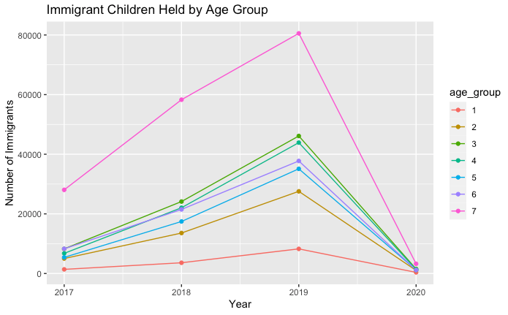
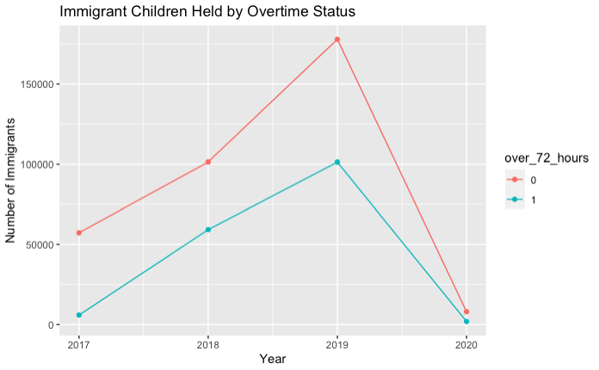
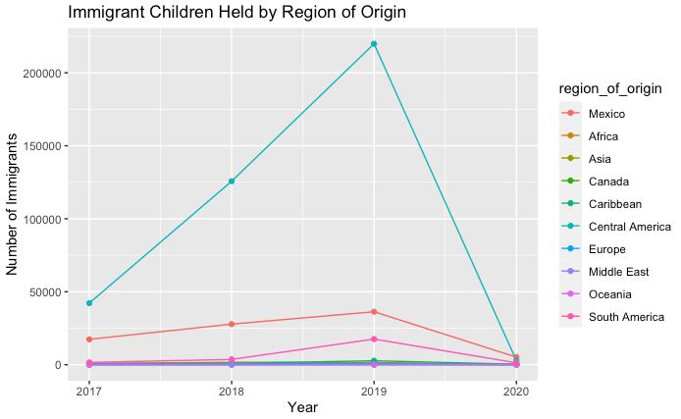
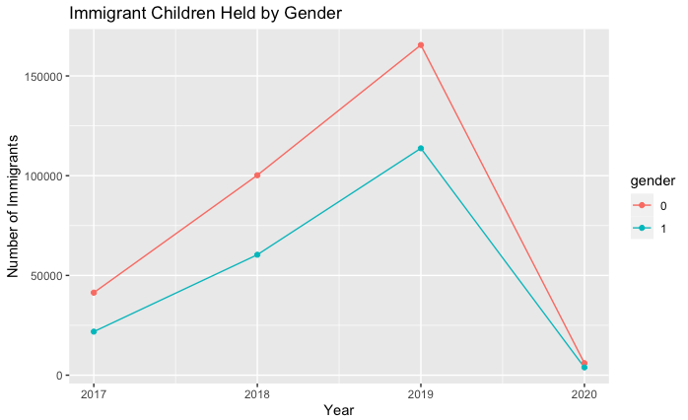
Notes:
Age groups:
1: 0-1
2: 1-2
3: 3-5
4: 6-8
5: 9-11
6: 12-14
7:15-18
Regions:
Central America, Mexico, south America
2020 – pandemic shut down borders

Slide 9
METHODS
Logistic Regression Model
Naïve Bayes Model
Logistic Regression Classification Model
Decision Tree Model
Notes:
In order to answer whether immigrant children of certain nationalities, genders, and ages were more likely to spend more than 72 hours in a detention facility than others, a logistic regression model was created.
The full logistic regression model looked at overtime in detention facilities based on immigrant gender, age group, region of origin, and year.
Second, a naive bayes classification model was created to predict an immigrant child’s odds of overtime in a detention facility. The dataset was converted to factors to feed into the model. The dataset was then split into a training set and a test set with a 70/30 split. The naive bayes classification model was created using the training dataset. Contingency tables on the training dataset and the test dataset were generated and then the accuracy scores on both sets were calculated.
Third, a logistic regression classification model was created to predict an immigrant child’s odds of overtime in a detention facility. The dataset was split into a training set and a test set with a 70/30 split. A classification model was built using the training data, and the model performance was evaluated on the training set and the test set through accuracy scores. Fourth, a logistic regression classification model was made with a balanced dataset in which the over_72_hours = 1 datapoints and over_72_hours = 0 datapoints were equal in number (See Section 5. Results were detailed step-by-step code).
Fifth, a decision tree classifier was made with four different balanced datasets in which the datapoints in which over_72_hours = 1 and over_72_hours = 0 were equal (see Appendix 4 for detailed step-by-step code).

Slide 10


Logistic regression
An immigrant child who is female, 6-8 years old, kept in the year 2020, and from Central America has the highest odds of being detained longer than the 72-hour time limit

Slide 11
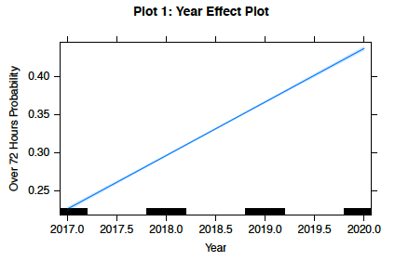
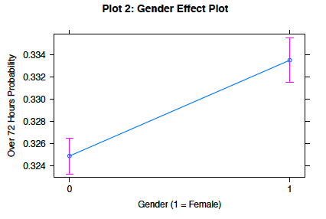
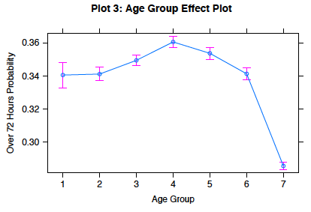
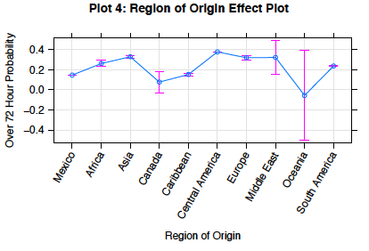
Notes:
Plot 1:
• Every year from 2017 onwards has a higher expected probability of detainment longer than 72 hours
Plot 2:
• Female immigrant children have a higher expected probability of being detained longer than 72 hours than males (0.332 vs. 0.325)
Plot 3:
• Immigrant children in age group 7 (15-18 years old) have the lowest expected probability of being detained longer than 72 hours (0.28)
• Immigrant children in age group 4 (6-8 years old) have the highest expected probability of being detained longer than 72 hours (0.36)
Plot 4:
• Immigrant children from Central America have the highest expected probability of being detained longer than 72 hours (0.3)
• Immigrant children from Canada have the lowest expected probability (with the lowest error bar) of being detained longer than 72 hours (0.1)
Scope of Inference:
The scope of inference for this report is based on the data used, in that scope would lie within the United
States’ child detentions reported by the CBP Office of Field Operations and the CBP Border Patrol between
mid-January 2017 and late January 2020.

Slide 12

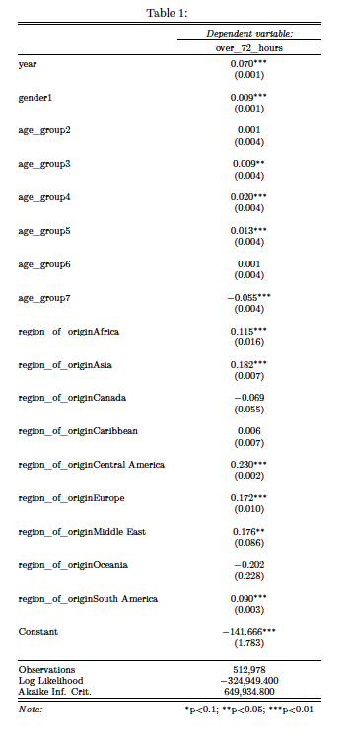
Notes:
Year:
• For every one-year increase from 2017 to 2020, the log odds of overtime increases by 0.07
Gender:
• Being female instead of male increases the log odds of overtime by 0.009
Age Group:
• An immigrant child in age group 3 (3-5 years old), versus an immigrant in age group 1, increases the log
odds of overtime by 0.009
• An immigrant child in age group 4 (6-8 years old), versus an immigrant in age group 1, increases the log
odds of overtime by 0.020
• An immigrant child in age group 5 (9-11 years old), versus an immigrant in age group 1, increases the log
odds of overtime by 0.013
• An immigrant child in age group 7 (15-18 years old), versus an immigrant in age group 1, decreases the
log odds of overtime by 0.055
Region of Origin:
• An immigrant child from Europe, versus an immigrant from Mexico, increases the log odds of overtime
by 0.172
• An immigrant child from Asia, versus an immigrant from Mexico, increases the log odds of overtime by
0.182
• An immigrant child from Africa, versus an immigrant from Mexico, increases the log odds of overtime by
0.115
• An immigrant child from Central America, versus an immigrant from Mexico, increases the log odds of
overtime by 0.230
• An immigrant child from Middle East, versus an immigrant from Mexico, increases the log odds of overtime
by 0.176
• An immigrant child from South America, versus an immigrant from Mexico, increases the log odds of
overtime by 0.090

Slide 13
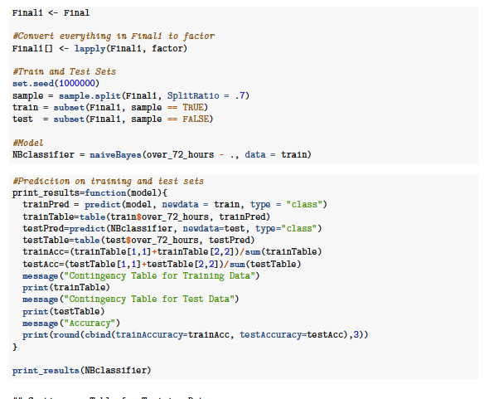
naïve bayes classification model:
Confusion Matrix: Training Data
 | 0 | 1
0 | 205553 | 24393
1 | 92914 | 19126
66% Accuracy
Confusion Matrix: Test Data
 | 0 | 1
0 | 102598 | 12050
1 | 46857 | 9487
65% Accuracy

Slide 14
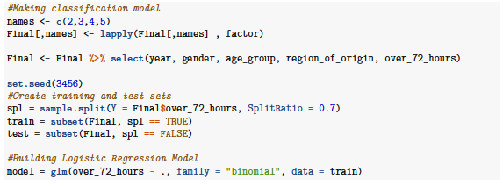
Logistic regression classification model:
Confusion Matrix: Training Data
 | 0 | 1
0 | 240592 | 624
1 | 117436 | 433
67% Accuracy
Confusion Matrix: Test Data
 | 0 | 1
0 | 103098 | 280
1 | 50338 | 177
67% Accuracy

Slide 15
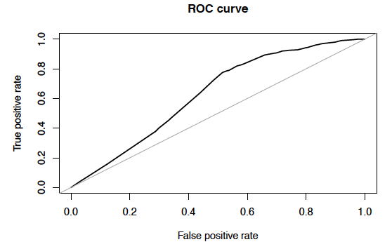
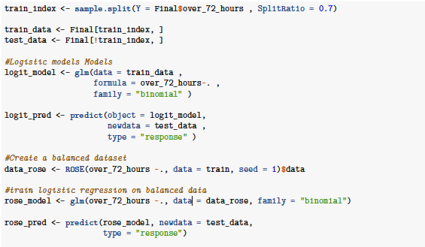

Logistic regression classification model: with undersampling
Area under the curve: 0.630
Notes:
Next, a logistic regression classification model was created with a balanced dataset. A balanced dataset
was achieved through undersampling so the number of data points in which over_72_hours = 1 and
over_72_hours = 0 were the same. The accuracy score remained around the same. The area under the
ROC curve was 0.629.

Slide 16
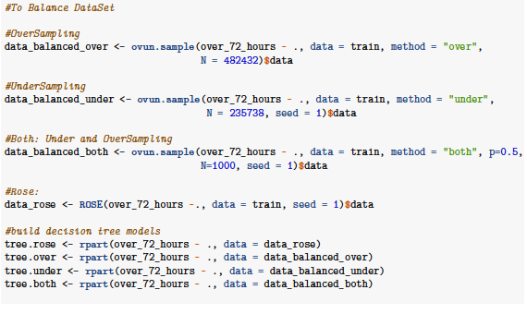
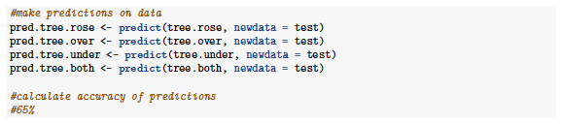
Decision tree classifier: balanced dataset
Accuracy of every sample was ~65%

Slide 17
Limitations & discussion
LIMITATIONS
No causal claims between immigrant children characteristics and overtime
No extrapolation
Low accuracy on classification models
Imbalanced datasets
DISCUSSION
Confirms that during Trump’s presidency, thousands of immigrant children were kept over the 72 legal hour limit; certain immigrant children based on characteristics were kept longer than others
Notes:
There are limitations to this study. First, no causal claims between immigrant children characteristics and
being kept overtime in a detention facility can be made because there was no randomized treatment nor
administered randomization. In addition, this study’s findings cannot be extrapolated outside of the years
2017 to 2020. Instead, this study confirms correlations between certain immigrant characteristics and the
odds of being detained overtime. This study confirms that during Donald Trump’s presidency, thousands of
immigrant children were kept over the 72 hour limit at detention facilities, and further supports the theory
that Trump disregarded the human rights of thousands of immigrants and their children. The classification
models built also need to be used with discretion because of their accuracy scores around 65%.

Slide 18
conclusion
Expansion on the existing literature centered on evaluation of the immigration policy under President Trump
Immigrant children of certain nationalities, genders, and ages are more likely to be detained over 72-hour limit than others
The classification models allow predictions to be made on the likelihood of an immigrant child being kept over the 72-hour time limit in detention facilities under Trump
→ remains value in giving policymakers an idea of the demographics of immigrant children most affected by Trump’s immigration policies
Allow policymakers in the Biden administration to determine which groups of immigrants they need to focus their attention on to quickly reunify families and create a more humane and efficient detention system
Notes:
Under the Trump administration, children were held in cages, lived in freezing temperatures, and were
separated from their parents. Trump not only failed to provide the basic standards of care immigrants were
required to receive, but also failed to respect basic human rights. With the limited data available from 2017
to 2020, this study has completed data analysis to expand on the existing literature centered on immigration
policy under President Trump.

